Slide 1
Course Name: CS302-Design an analysis of Algorithm Credit Hours: 3
Week-2

Slide 2
Algorithm analysis
Objective:
Performance analysis is the criteria for judging the algorithm.
It have direct relationship to efficiency.
When we solve a problem ,there may be more then one algorithm to solve a problem, through analysis we find the run time of an algorithms and we choose the best algorithm which takes lesser run time.

Slide 3
Analysis of an Algorithm
What is analysis of an algorithm?
Algorithm analysis is an important part of a computational complexity theory.
There two types of analysis:
1.priori
2.posteriori
Priori Analysis is the theoretical estimation of resources required.
On the other hand posterior Analysis done after implement the algorithm on a target machine. In a posteriori analysis, we analyze actual statistics about the algorithms consumption of time and space, while it is executing.

Slide 4
Strengthening the Informal Definition
Important Features:
Finiteness: Algorithm should end in finite amount of steps
Definiteness : each instruction should be clear
Input: valid input clearly specified
Output: single/multiple valid output
Effectiveness: steps are sufficiently simple and basic
Generality: the algorithm should be applicable to all
problems of a similar form

Slide 5
What is the specification of algorithm?
We can specify an algorithm by 3 types:
Using Natural language
Pseudocode
Flowchart.

Slide 6
Running Time
Most algorithms transform input objects into output objects.
The running time of an algorithm typically grows with the input size.
We focus on the worst case running time.
Easier to analyze
Crucial to applications such as games, finance and robotics

Slide 7
Experimental Studies
Write a program implementing the algorithm
Run the program with inputs of varying size and composition
Use a method like (tic; toc; in Matlab) to get an accurate measure of the actual running time
Plot the results

Slide 8
Limitations of Experiments
It is necessary to implement the algorithm, which may be difficult
Results may not be indicative of the running time on other inputs not included in the experiment.
In order to compare two algorithms, the same hardware and software environments must be used

Slide 9
Theoretical Analysis
Uses a high-level description of the algorithm (Pseudo code) instead of an implementation
Characterizes running time as a function of the input size, n.
Takes into account all possible inputs
Allows us to evaluate the speed of an algorithm independent of the hardware/software environment

Slide 10
Asymptotic Notations

Slide 11
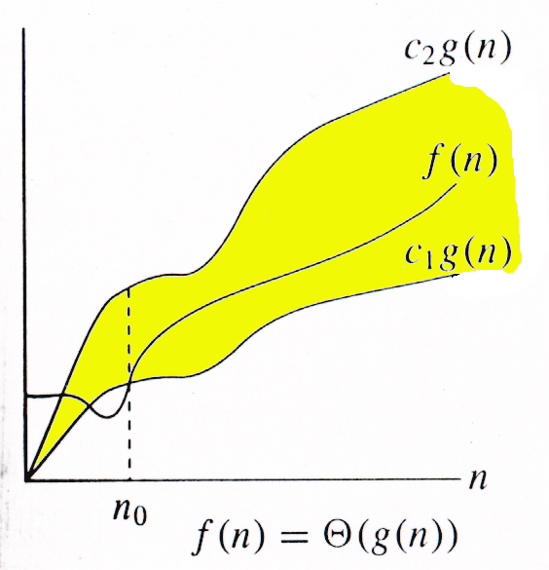
Θ-notation
For function g(n), we define Θ(g(n)), big-Theta of n, as the set:
Θ(g(n)) = {f(n) : ∃ positive constants c₁, c₂, and n_{0,} such that ∀n ≥ n₀,
we have 0 ≤ c₁g(n) ≤ f(n) ≤ c₂g(n)
}
Intuitively: Set of all functions that
have the same rate of growth as g(n).
g(n) is an asymptotically tight bound for f(n).

Slide 12

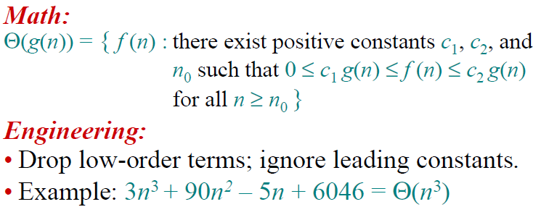

Slide 13
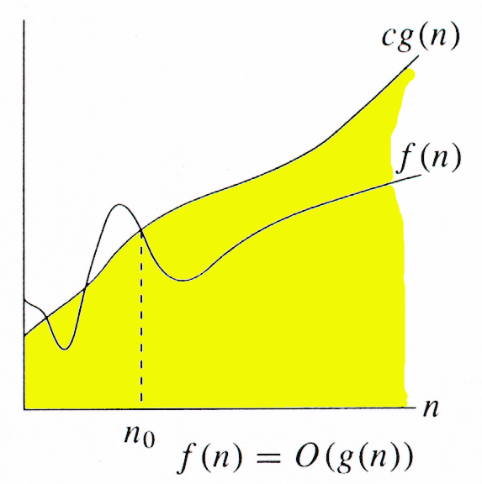
O-notation
For function g(n), we define O(g(n)), big-O of n, as the set:
O(g(n)) = {f(n) : ∃ positive constants c and n_{0,} such that ∀n ≥ n₀,
we have 0 ≤ f(n) ≤ cg(n) }
Intuitively: Set of all functions whose rate of growth is the same as or lower than that of g(n).
g(n) is an asymptotic upper bound for f(n).
f(n) = Θ(g(n)) ⇒ f(n) = O(g(n)).
Θ(g(n)) ⊂ O(g(n)).

Slide 14
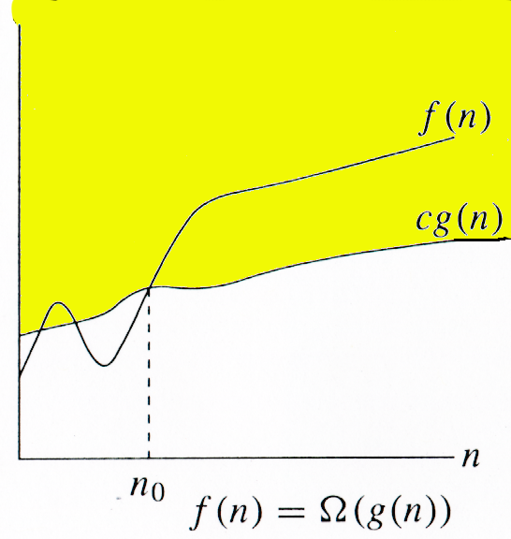
Ω -notation
For function g(n), we define Ω(g(n)), big-Omega of n, as the set:
Ω(g(n)) = {f(n) : ∃ positive constants c and n_{0,} such that ∀n ≥ n₀,
we have 0 ≤ cg(n) ≤ f(n)}
Intuitively: Set of all functions whose rate of growth is the same as or higher than that of g(n).
g(n) is an asymptotic lower bound for f(n).
f(n) = Θ(g(n)) ⇒ f(n) = Ω(g(n)).
Θ(g(n)) ⊂ Ω(g(n)).

Slide 15
Relations Between Θ, O, Ω

Slide 16
Relations Between Θ, Ω, O
Theorem : For any two functions g(n) and f(n), f(n) = Θ(g(n)) iff
f(n) = O(g(n)) and f(n) = Ω(g(n)).
I.e., Θ(g(n)) = O(g(n)) ∩ Ω(g(n))
In practice, asymptotically tight bounds are obtained from asymptotic upper and lower bounds.

Slide 17
Ω
O

Slide 18
Asymptotic Notation
O notation: asymptotic “less than”:
f(n)=O(g(n)) implies: f(n) “≤” g(n)
Ω notation: asymptotic “greater than”:
f(n)= Ω (g(n)) implies: f(n) “≥” g(n)
Θ notation: asymptotic “equality”:
f(n)= Θ (g(n)) implies: f(n) “=” g(n)

Slide 19
=> (3n+2)=Ω (n²) ?????
No
=> f(n)= Ω (n)
if f(n) is lower bounded by ‘n’ then it can be lower bounded by any g(n) which is lower bounded by ‘n’
i-e (3n+2)=Ω (logn)
(3n+2)=Ω (log (log (n)))
But we always go for the closest lower bound or tighter lower bound

Slide 20
If (3n+2)=O(n)
=> (3n+2)=O (n²)
=> (3n+2)=O (n³)
=> (3n+2)=O (n⁴) so on…
But we always go for the least upper bound or tighter upper bound

Slide 21
3n+2=Θ(n)
3n²+2n+1=Θ(n²)
6n³+n²=Θ(n³)

Slide 22

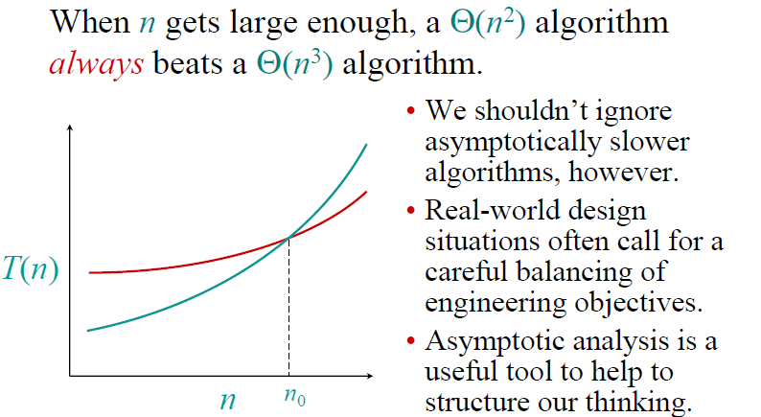

Slide 23
Examples of algorithms
Here is a list of common asymptotic running times:
Θ(1): Constant time; can’t beat it!
Θ(log n): Inserting into a balanced binary tree; time to ﬁnd an item in a sorted array of length n using binary search.
Θ(n): About the fastest that an algorithm can run.
Θ(n log n): Best sorting algorithms.
Θ(n²), Θ(n³): Polynomial time. These running times are acceptable when the exponent of n issmall or n is not to large, e.g., n ≤ 1000.
Θ(2^{n}), Θ(3^{n}): Exponential time. Acceptable only if n is small, e.g., n ≤ 50.
Θ(n!) : Acceptable only for really small n, e.g. n ≤ 20.

Slide 24
Best worst and average time complexity
Best case: The algorithm take as min time as it can.
Searching item in array
Found first item as key
Worst case: The algorithm take max time as it can
Searching item in array
Found the last item/ did not found item
Average case: The algorithm takes average time
Found in middle of array (Just example)

Slide 25
What is the relationship between Big O, Θ, Ω and best, worst, and average case of an algorithm?
The Ο and Ω notations do only describe the bounds of a function that describes the asymptotic behavior of the actual behavior of the algorithm. Here’s an example
Ω describes the lower bound:
f(n) ∈ Ω(g(n)) means the asymptotic behavior of f(n) is not less than g(n)·k for some positive k, so f(n) is always at least as much as g(n)·k.
Ο describes the upper bound:
f(n) ∈ Ο(g(n)) means the asymptotic behavior of f(n) is not more than g(n)·k for some positive k, so f(n) is always at most as much as g(n)·k.
We are usually interested in the worst case complexity

Slide 26
Best worst average vs Notations
These two can be applied on both the best case and the worst case for binary search:
best case: first element you look at is the one you are looking for
Ω(1): you need at least one lookup
Ο(1): you need at most one lookup
worst case: element is not present
Ω(log n): you need at least log n steps until you can say that the element you are looking for is not present
Ο(log n): you need at most log n steps until you can say that the element you are looking for is not present
But often we do only want to know the upper bound or tight bound as the lower bound has not much practical information.
Compare with finding max in array

Slide 27
Estimating Running Time
For example any Algorithm executes 7n + 1 primitive operations in the worst case.
Define:
a = Time taken by the fastest primitive operation
b = Time taken by the slowest primitive operation
Let T(n) be worst-case time of arrayMax. Then a (7n + 1) ≤ T(n) ≤ b(7n + 1 )
Hence, the running time T(n) is bounded by two linear functions

Slide 28
Simple Example (1)
// Input: int A[N], array of N integers
// Output: Sum of all numbers in array A
int Sum(int A[], int N)
{
int s=0;
for (int i=0; i< N; i++)
s = s + A[i];
return s;
}
How should we analyse this?

Slide 29
Example of Basic Operations:
Arithmetic operations: *, /, %, +, -
Assignment statements
Simple conditional tests: if (x < 12) ...
method call (Note: the execution time of the method itself may depend on the value of parameter and it may not be constant)
a method's return statement
Memory Access
We consider an operation such as ++ , += , and *= as consisting of two basic operations.
Note: To simplify complexity analysis we will not consider memory access (fetch or store) operations.

Slide 30
Simple Complexity Analysis: Loops
We start by considering how to count operations in for-loops.
We use integer division throughout.
First of all, we should know the number of iterations of the loop; say it is x.
Then the loop condition is executed x + 1 times.
Each of the statements in the loop body is executed x times.
The loop-index update statement is executed x times.

Slide 31
Simple Example (2)
// Input: int A[N], array of N integers
// Output: Sum of all numbers in array A
int Sum(int A[], int N){
int s=0;
for (int i=0; i< N; i++)
s = s + A[i];
return s;
}
1
2
3
4
5
1,2,8: Once
3,4,5,6,7: Once per each iteration
of for loop, N iteration
Total: 5N + 3
The complexity function of the
algorithm is : f(N) = 5N +3
6
7
8

Slide 32
Example explanation
Estimated running time for different values of N for 5N+3:
N = 10 => 53 steps
N = 100 => 503 steps
N = 1,000 => 5003 steps
N = 1,000,000 => 5,000,003 steps
As N grows, the number of steps grow in linear proportion to N for this function “Sum”

Slide 33
What Dominates in Previous Example?
What about the +3 and 5 in 5N+3?
– As N gets large, the +3 becomes insignificant
– 5 is inaccurate, as different operations require varying amounts of time and also does not have any significant importance
Asymptotic Complexity: As N gets large, concentrate on the highest order term:
Drop lower order terms such as +3
Drop the constant coefficient of the highest order term i.e. N
The 5N+3 time bound is said to "grow asymptotically" like N

Slide 34
Rate of Growth
Consider the example of buying elephants and goldfish:
Cost: cost_of_elephants + cost_of_goldfish
Cost ~ cost_of_elephants (approximation)
The low order terms in a function are relatively insignificant for large n
n⁴ + 100n² + 10n + 50 ~ n⁴
i.e., we say that n⁴ + 100n² + 10n + 50 and n⁴ have the same rate of growth
34

Slide 35
Simple Complexity Analysis: Loops (with <)
In the following for-loop:
The number of iterations is: (n – k ) / m
The initialization statement, i = k, is executed one time.
The condition, i < n, is executed ((n – k) / m )+ 1 times.
The update statement, i = i + m, is executed (n – k) / m times.
Each of statement1 and statement2 is executed (n – k) / m times.
for (int i = k; i < n; i = i + m){
statement1;
statement2;
}

Slide 36
Simple Complexity Analysis: Loop Example
Find the exact number of basic operations in the following program fragment:
There are 2 assignments outside the loop => 2 operations.
The for loop actually comprises
an assignment (i = 0) => 1 operation
a test (i < n) => n + 1 operations
an increment (i++) => n operations
the loop body that has three assignments, two multiplications, and an addition 2 array access=> 8 n operations
Thus the total number of basic operations is 8 * n + n + (n + 1) + 3
= 10n + 4
double x, y;
x = 2.5 ; y = 3.0;
for(int i = 0; i < n; i++){
a[i] = x * y;
x = 2.5 * x;
y = y + a[i];
}

Slide 37
Running Time Calculations
Simple for loop
int Sum (int N) {
/* 1 */ int sum = 0;
/* 2 */ for (int i =1; i <= N; i++)
/* 3 */ sum = sum + i * i * i;
/* 4 */ return sum ; }
Q: What is the running time?
Line 1 & 4 → 2 units of time → 2
Line 2 → 1 unit (initialize) + (N +1) tests + N Increments → 2N + 2
Line 3 → 4 units (1 add, 2 muls., 1 assign) * N executions → 4N
Total → 6N + 4
A: O(N)

Slide 38
Be careful to differentiate between
Performance: how much time/memory/disk/... is actually used when a program is run. This depends on the machine, compiler, etc. as well as the code.
Complexity: how do the resource requirements of a program or algorithm scale, i.e., what happens as the size of the problem being solved gets larger.

Slide 39
Standard Analysis Techniques
Constant time statements
Analyzing Loops
Analyzing Nested Loops
Analyzing Conditional Statements

Slide 40
Constant time example
Simplest case: O(1) time statements
Assignment statements of simple data types
int x = y;
Arithmetic operations:
x = 5 * y + 4 - z;
Array referencing:
A[j] = 5;

Slide 41
Analyze Loop
Any loop has two parts:
– How many iterations are performed?
– How many steps per iteration?
int sum = 0,j;
for (j=0; j < N; j++)
sum = sum +j;
– Loop executes N times (0..N-1)
– O(1) steps per iteration
• Total time is N * O(1) = O(N*1) = O(N)

Slide 42
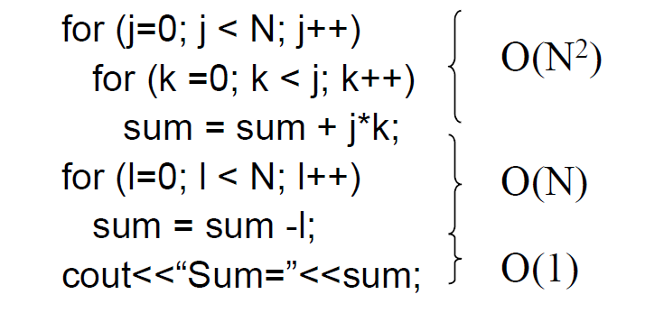
Nested and consecutive loops
For a sequence of statements, compute their complexity functions individually and add them up
Total cost is O(N2) + O(N) +O(1) = O(N2)
Or N square

Slide 43
Nested loop
for(i=0;i<n;i++) for(i=0;i<n;i++)
{ { } for(j=0;j<n;j++) for(j=0;j<n;j++)
{ { } for(k=0;k<n;k++) for(k=0;k<n;k++) { } { }
}
}
O(n³) O(n)

Slide 44
if (condition)
statement1;
else
statement2;
where statement1 runs in O(N) time and statement2 runs in O(N2) time?

Slide 45
Why it is important
Suppose a program has run time O(n!) and the run time for
n = 10 is 1 second
For n = 12, the run time is 2 minutes
For n = 14, the run time is 6 hours
For n = 16, the run time is 2 months
For n = 18, the run time is 50 years
For n = 20, the run time is 200 centuries

Slide 46
Task
for (i=0; i<n; i++)
{for (j=0; j<n;j++)
{
Sequence of statements….
}
}

Slide 47
Statements with Function call
for(i=0;i<n;i++) { g(n); }

Slide 48
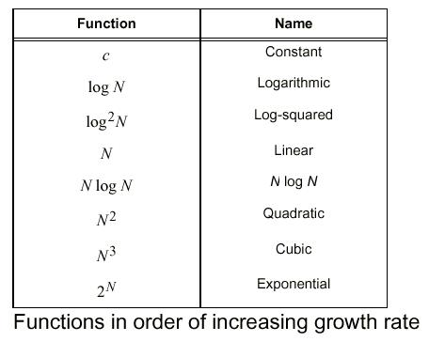
Function of Growth rate

Slide 49
Comparing the asymptotic running time
An algorithm that runs in O(n) time is better than the one that runs in O(n²) time
Similarly, O(log n) is better than O(n)
Hierarchy of functions:
log n << n << n² << n³ << 2^{n}

Slide 50
A loop that runs a constant number of times is also considered as O(1).
Here c is a constant for
For example the following loop is O(1).
(int i = 1; i <= c; i++)
{ // some O(1) expressions }

Slide 51
O(n): Time Complexity of a loop is considered as O(n) if the loop variables is incremented / decremented by a constant amount. For example following functions have O(n) time complexity.
// Here c is a positive integer constant
for (int i = 1; i <= n; i += c)
{ // some O(1) expressions }
for (int i = n; i > 0; i -= c)
{ // some O(1) expressions }

Slide 52
O(n^{c}): Time complexity of nested loops is equal to the number of times the innermost statement is executed. For example the following sample loops have O(n²) time complexity
for (int i = 1; i <=n; i += a)
{ for (int j = 1; j <=n; j += a)
{ // some O(1) expressions } }

Slide 53
O(Logn) Time Complexity of a loop is considered as O(Logn) if the loop variables is divided / multiplied by a constant amount.
for (int i = 1; i <=n; i *= c)
{ // some O(1) expressions }
for (int i = n; i > 0; i /= c)
{ // some O(1) expressions }

Slide 54
Task
Write an algorithm to sort the data in array.

